Slide 1
SQL for Data Querying and Analysis
Week 3 Lecture

Slide 2
Agenda
Review
Sub Queries
Conditional Logic

Slide 3
Review
A primary key is a unique identifier within a table while a foreign key serves as a link to another table where the same values serve as a primary key
A join is an operation that uses related columns (primary/foreign) between tables to combine data from multiple tables into one query. Located in the from clause!
You can use joins to join more than 2 tables at a time (table aliases helpful here!)
Sets and set operators are a great way to combine, filter, and manipulate your data across multiple sources
Sets must have the same number of columns and the same types for corresponding columns

Slide 4
Sub Queries

Slide 5
Sub Queries
Sub queries are a query within another query (containing query)
Always contained with parenthesis!
Like any SQL query, sub queries can return…
Single row and single column
Multiple rows and single column
Multiple rows and multiple columns
Sub queries are executed before the rest of the query

Slide 6
Scalar Sub Queries
A sub query that returns a single row and single column is called a scalar sub query
They are most frequently used as part of a condition referencing equality/inequality (=, <>, >=, <=, >, <)
When using a sub query as part of an equality condition the sub query must return a single row and single column
In other words… it must be scalar!

Slide 7
Demo Set 3.1

Slide 8
Multi Row Single Column Sub Queries
Multiple row single column sub queries are used similarly to scalar sub queries
However, we check for membership instead of equality
We cannot equate a single value to a set of values
Use the IN and NOT IN operators with these sub queries as opposed to our equality/inequality operators

Slide 9
Demo Set 3.2

Slide 10
ANY and ALL Operators
The ANY and ALL operators offer a way to compare a single value to multiple values
ANY and ALL don’t have to be used in conjunction with a sub query but usually are
For the ALL condition to be satisfied the specified condition must be met for all the values in the sub query
For the ANY condition to be satisfied the specified condition must be met for any of the values in the sub query
These operators are frequently used in the having clause

Slide 11
Demo Set 3.3

Slide 12
Multi Column Multi Row Sub Queries
Used similarly to multi row single column sub queries
Checking for membership, but across multiple columns
Not frequently used but a good tool to have in your SQL toolbox!

Slide 13
Demo Set 3.4

Slide 14
Sub Queries using Exists
EXISTS operator is useful when you want to identify if a relationship exists without regard for quantity
Using the EXISTS operator, a sub query can return zero, one or many rows and the condition checks if the sub query returned at least one row
If condition is met, values for columns in SELECT clause are returned
You can also use the NON EXISTS operator to return values to the results set when the condition is not met

Slide 15
Demo Set 3.5

Slide 16
Sub Queries as a Data Source
Remember a table in the FROM clause can be many things…
Including the result of a sub query!
When a sub query is included in the FROM clause it is considered a data source
Very powerful because you can customize what inputs go into a join
A common use is pairing an inner join with a subquery to filter rows to a specific subset of values

Slide 17
Demo Set 3.6

Slide 18
Sub Queries as a Common Table Expression
Common Table Expressions (CTEs) leverage sub queries in the WITH clause (new clause alert!!!)
WITH clause is positioned before the SELECT clause
All CTEs are established at the beginning of the query and given names which are referenced later in the main containing query
CTEs are effective when there are many sub queries in your query
Improves organization but can hurt interpretability! (in my opinion)

Slide 19
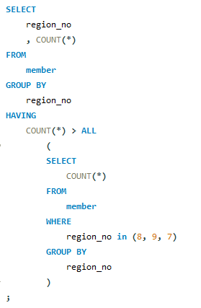
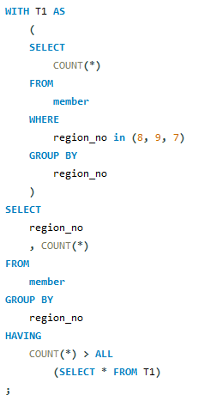
Which regions have higher member populations than regions 8, 9, and 7?

Slide 20
Demo Set 3.7

Slide 21
Conditional Logic

Slide 22
What is Conditional Logic?
Conditional logic is the ability to take one of multiple paths during the execution of a program
Think IF -> THEN
The CASE expression is SQL’s optimal method to express and execute conditional logic
CASE expressions are executed in the SELECT cause (for our purposes)

Slide 23
Searched CASE Expressions
Searched CASE expressions are the most common use for CASE expressions
Can return a string, expression, column value or even the result of a sub query
The value following ELSE in a searched CASE expression is considered the default value of the expression
Once a condition in the expression is met, the rest of the expression is ignored

Slide 24
Demo Set 3.8

Slide 25
Result Set Transformations
CASE expressions can help when you want results all in one row
Similar to transposing the results of a GROUP BY
Using CASE to transform your result requires much code but is very flexible!
A separate CASE expression is required for each column desired in your result

Slide 26
Demo Set 3.9

Slide 27
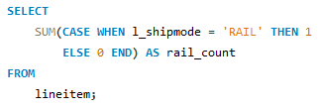

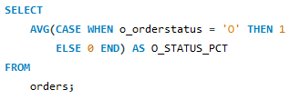

Result Transformation Update!
There is a recently added new syntax to perform result set transformation
No longer need to use CASE expressions
=
=

Slide 28
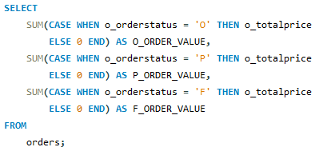

Result Transformation Update! Cont.
Important to remember that this syntax only works when you are looking at counts of rows
If you want to aggregate on actual amounts in the table you will need to use CASE expressions

Slide 29
Review!
Sub queries are a query within another query
The result of a sub query can be a single row and single column, multiple rows and single column or multiple rows and multiple column
Sub queries are executed before the rest of the query
The CASE expression is SQL’s optimal method to express and execute conditional logic
CASE expressions and sub queries are often used together!

Slide 30
Resources to Practice
Code Academy SQL Course: https://www.codecademy.com/learn/learn-sql
SQL Zoo: https://sqlzoo.net/
W3 Schools: https://www.w3schools.com/sql/sql_exercises.asp

Slide 31
Thank You!

